Slide 1
Git! LabVIEW, Git!
Part 1: Introduction and What is Git?
Presented by Seth Kazarians, MSEE

Slide 2
Goal and Target Audience
Goals
Find and describe the intersection of LabVIEW and Git.
Present a guide to the tools available for using Git with LabVIEW.
Ideal Target Audience
Has LabVIEW experience, but has little Git (or revision control) experience
Notes:
Explain “Core feature set’ Wording better
Worst Case Audience
Git experts!
I apologize in advance for any gross simplifications and errors.
Please try to avoid “but what about…”s. I will be focusing on the core feature set and not any extra modules.

Slide 3
Expectations
Expectations from this
Part 1: Will learn about Git and Revision Control
Part 2: Will learn about how to work with Git
Part 3: Will learn about LabVIEW and Git combined
What not to expect
An in depth look at Git

Slide 4
Outline
Defining Revision Control and its benefits
Comparing and contrasting the two styles of revision control
Going over some background concepts and definitions
Explaining how Git works

Slide 5
What is Revision Control?
Revision control is a method of capturing:
Snapshots of files (code, etc.) at specific points in time
Some meta-data around the snapshot
Put those snapshots in order
What happens if I don’t have revision control?
Revision control can fix that!
Notes:
“I have this awesome software I developed that does everything I need, but it has this one tenacious bug. I just spent the last 3 weeks finding this bug, and it turned out that it was a simple setting/register/subVI. But now, I don’t remember all the things I changed in trying to find that one thing I needed to change.”

Slide 6
Benefits
For a solo developer:
Snapshots of code (or docs) at known states.
Better independence of development, when working on independent features
For a team:
Individual developers can make commits on the same code at the same time without being locked out.
Known states of codebases to develop against.
Notes:
Better Define Locked out.

Slide 7
Client/Server Model
Ex: Subversion (SVN), Perforce, Surround SCM, Team Foundation Server
Simplest in terms of explaining the hierarchy and modus operandi.
The server acts as the master.
It stores a copy of EVERY file that is revision controlled.
It stores the revision history.
It determines who has access to the files, and who can make changes
A client is beholden to the server.
Clients only have copies of the files they pulled or checked out.
Clients can only make changes while connected to the server.
Changes cannot be captured simultaneously.

Slide 8
Distributed Model
Ex: Git, Mercurial
Everyone has a copy!
Every person who is participating in revision control has a complete copy of the code.
Everyone is a master….in their own little realm.
Each developer can do whatever they want to their own repository. It’s only when sharing that repo that any enforcement of rules happens.
Simultaneous submitting of changes can be done now, but you bring on the burden of reconciliation.
Notes:
Better define work

Slide 9
Distributed Model (Caveats)
Who is the source of authority?
Determine this ahead of time
If working in a team, you must have good communication and teamwork
Seems like it could be chaos.
This can be managed through some rules and workflows.
Example workflows: Gitflow & Github Flow
Notes:
Better define work

Slide 10
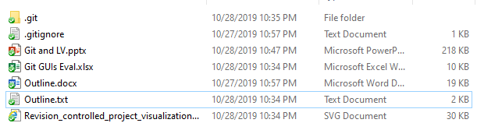
Repositories
Store the files you want to track
Are a single folder
Contain all the git meta-data.
Contain ALL the changes that have been made to the files being tracked.

Slide 11
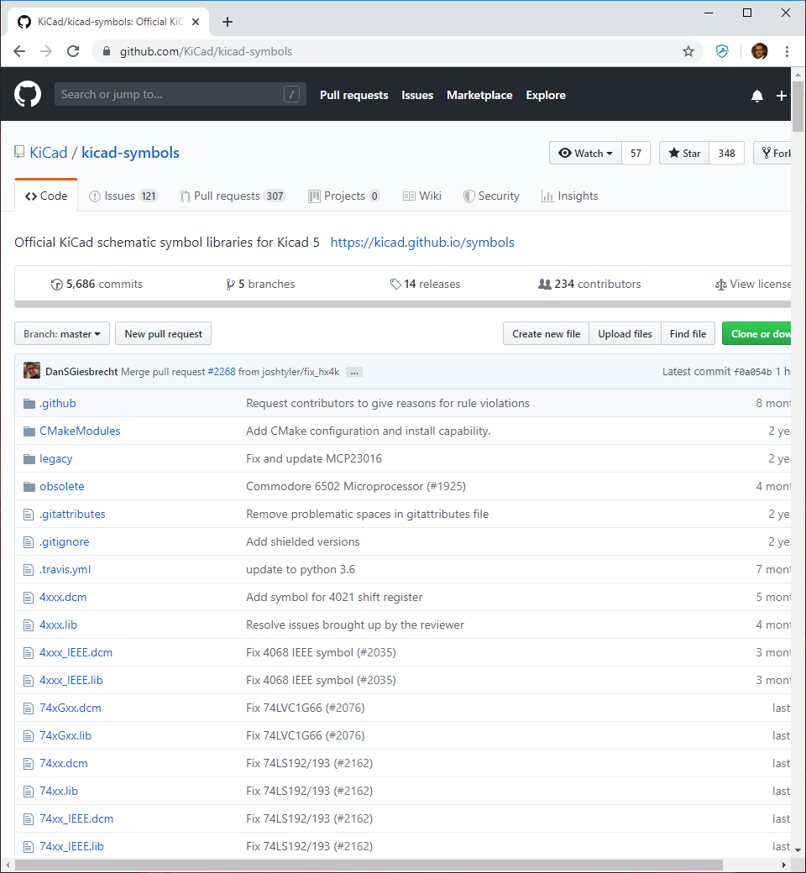
GitHub/GitLab/ BitBucket/etc.
These are what most people think of when they think of Git.
They are simply a place to store repos on a remote server.

Slide 12
How Does Git Work?
Three primary activities
Committing (making a new snapshot in time)
Branching/Merging (aka unbranching)
Distributing (Push and Pull)
Everything else serves these three functions.

Slide 13
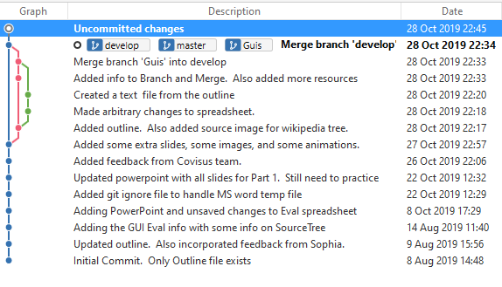
Commit
A commit is a single snapshot in time.
Places a snapshot of the files into the change history.
The individual developer decides what is or isn’t included.
“Commit early and commit often.”

Slide 14
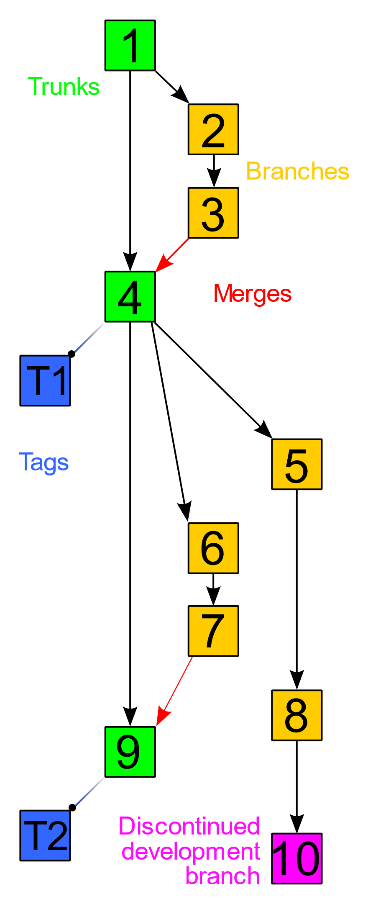
Branching
A branch is (effectively) a copy of the working set that can be modified independently of other branches.
Checking out branches shelves all the changes you’ve made and brings up all the changes you’ve made on the other branch.
(CC BY-SA 3.0, Stannered & Sami Kerola)
Notes:
Add Visual References (Atlassian Diagrams)
By Revision_controlled_project_visualization.svg: *Subversion_project_visualization.svg: Traced by User:Stannered, original by en:User:Sami Keroladerivative work: Moxfyre (talk)derivative work: Echion2 (talk) - Revision_controlled_project_visualization.svg, CC BY-SA 3.0, https://commons.wikimedia.org/w/index.php?curid=9562807

Slide 15
Merging
Merging is the act of applying the changes from one branch to another branch.
Typically merges are linked with deleting the branch that was merged, but is not mandatory.
(CC BY-SA 3.0, Stannered & Sami Kerola)
Notes:
Add Visual References (Atlassian Diagrams)
By Revision_controlled_project_visualization.svg: *Subversion_project_visualization.svg: Traced by User:Stannered, original by en:User:Sami Keroladerivative work: Moxfyre (talk)derivative work: Echion2 (talk) - Revision_controlled_project_visualization.svg, CC BY-SA 3.0, https://commons.wikimedia.org/w/index.php?curid=9562807

Slide 16
Push and Pull
These are the way changsets are shared.
Pushing is the act of moving the changeset from your repo to another repo.
Pulling is the opposite, taking changes from another repo and bringing it to your own.
Pull Requests are a very different thing.
(Short for: Requesting Someone Else To Pull Your Changes)
Are used to trigger reviews of the submitted changes.
Notes:
Split Pull and Pull Request

Slide 17
Demo

Slide 18
Questions?

Slide 19
Thank you

Slide 20
References
Atlassian Tutorial (https://www.atlassian.com/git/tutorials)
Git SCM docs (https://git-scm.com/docs/)
Git for Teams (O’Reilly Press & www.gitforteams.com)
GitFlow (https://datasift.github.io/gitflow/IntroducingGitFlow.html)
GitHub Flow (https://guides.github.com/introduction/flow/)
Git Large File Storage (Atlassian & GitHub)

